Slide 1
Automating Abstract Interpretation and Creating Improved Decision Procedures as a Bonus
Thomas Reps
University of Wisconsin and GrammaTech, Inc.
Notes:
Thank you for the opportunity to come and give this talk about the work I’ve done on automating abstract interpretation and its applications to creating improved decision procedures.

Slide 2

Unexpected Linkages
Computer Architecture
Programming Languages
Software Engineering
Operating Systems
Networking
Machine Learning
Automated
Reasoning
Notes:
I recently gave a version of this talk to a more general Computer-Science audience who I did not expect to understand the title, so I used this picture to try to summarize the high-level story visually.
As with all fields of knowledge, Computer Science is divided into subfields, but – because of the universal nature of computing – ideas in one subfield can have connections with other areas, and some of these can be quite surprising. In the work I will describe, we made interesting connections between the program-analysis problems that I was originally working on and some old ideas in machine learning and automated reasoning. The talk is thus neither about the left end of the line or the right end of the line, but about ideas common to both.
One meta-level comment: some parts of the talk may veer into technical topics specific to one end or the other, but my hope is that even if you don’t follow everything, you can get the gist of what my students, collaborators, and I have been trying to accomplish. To help out if you get lost, I’ve marked some points with a light bulb; these are places where I hope that at least the high-level point comes across, and you can get back on board with the bigger picture.

Slide 3
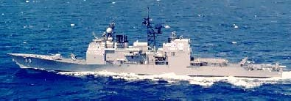
The administrator of the U.S.S. Yorktown’s Standard Monitoring Control System entered 0 into a data field for the Remote Data Base Manager program. That caused the database to overflow and crash all LAN consoles and miniature remote terminal units
The Yorktown was dead in the water for about two hours and 45 minutes
Notes:
I’m sure you all have a favorite example of a disastrous bug, but one of my favorite ones comes from 1998. <EXPLAIN>
I first heard of this bug in a talk by Peter Lee, who had a different description of the problem. He said, <click>

Slide 4
Analysis must
track numeric
information
A sailor on the U.S.S. Yorktown entered a 0 into a data field in a kitchen-inventory program
That caused an overflow, which crashed all LAN consoles and miniature remote terminal units
The Yorktown was dead in the water for about two hours and 45 minutes

Slide 5
x = 3;
y = 1/(x-3);
need to track values
other than 0
x = 3;
px = &x;
y = 1/(*px-3);
need to track
pointers
x = 3;
p = (int*)malloc(sizeof int);
*p = x;
q = p;
y = 1/(*q-3);
need to track
heap-allocated
storage
Notes:
That experience suggests that one try to have a program analyzer that tries to determine whether the program could have a division-by-0 error. But it is not that easy, because the 0 can be hidden in the computation. For instance, . . .

Slide 6
Static Analysis in a Nutshell
Determine information about the possible situations that can arise at execution time, without actually running the program on specific inputs
Typically:
For each point in the program, find a descriptor that represents (a superset of) the stores that could possibly arise at that point
Correctness of an analysis justified via abstract interpretation [Cousot & Cousot 77]
Notes:
Static-analysis tools provide a way to obtain information about the possible states that a program reaches during execution, but without actually running the program on specific inputs. Instead, they explore the program's behavior for all possible inputs, thereby accounting for all possible states that the program can reach. Operationally, one can think of abstract interpretation as running the program on finite-sized descriptors that represent collections of states.
The theory that underlies the field of program analysis is called “abstract interpretation,” which was developed by Patrick and Radhia Cousot starting in about 1975.

Slide 7


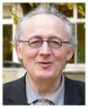
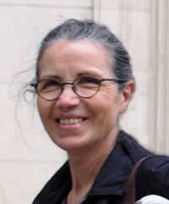
Automating Abstraction Interpretation
Abstract interpretation
A “black art” → hard to work with
20-year quest to raise the level of automation in abstract interpretation
3-valued logic analysis (TVLA)
with M. Sagiv, R. Wilhelm, T. Lev-Ami, A. Loginov, & many others
machine-code analysis (TSL)
with J. Lim
symbolic-abstraction algorithms
with M. Sagiv, G. Yorsh, A. Thakur
Reps, T. and Thakur, A., “Automating abstract
interpretation,” VMCAI, 2016.
research.cs.wisc.edu/wpis/papers/vmcai16-invited.pdf
Patrick
Cousot
Radhia
Cousot
Notes:
Abstract interpretation has many beautiful aspects, but also has a reputation of being a black art, and hard to work with successfully. <Click> Looking back at some of my work since the mid-90s, I now see that I’ve been engaged in a 20-year effort to raise the level of automation in this subject – and I want to describe part of this work in the remainder of the talk.
The first effort in this direction that I was involved in was motivated by the desire to create analyzers for programs that manipulate linked data structures. A later effort concerned analyzing programs written in machine code. There is far too much material here for a single talk, so I will concentrate on the third topic of symbolic-abstraction algorithms.
But I want to mention that, because Rustan and Barbara were generous with our page allowance, the accompanying paper in the VMCAI proceedings surveys all three efforts. I’ll say a little more about that in a few minutes.
So what do I mean by “automating abstract interpretation?” One way to think about it is that we would like to make using abstract interpretation push-button to the same degree that, say, parser-generation tools make parsing push-button.

Slide 8

What Does It Mean to Automate Parsing?
A parsing-problem instance Parse(L,s) has two inputs
L = a context-free language
s = a string to be parsed
The string changes more frequently than the language
A context-free language has a context-free grammar
Yacc (and later, Gnu Bison)
Input: a context-free grammar that describes the language L to be parsed
Output: a parsing function, yyparse(), for which
executing yyparse() on string s computes Parse(L,s)
Steve
Johnson
source: simple-talk interview
Notes:
. . . so let’s consider that problem. “What does it mean to automate the subject of parsing?”

Slide 9
What Does It Mean to Automate Program Analysis?
Follow a similar scheme . . .
But first, why would you even want to invest the time doing so?

Slide 10
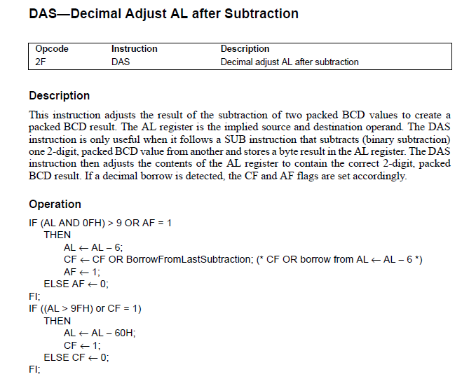
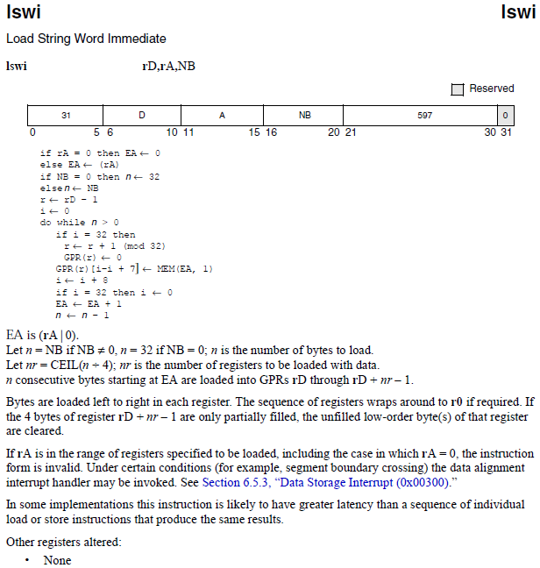
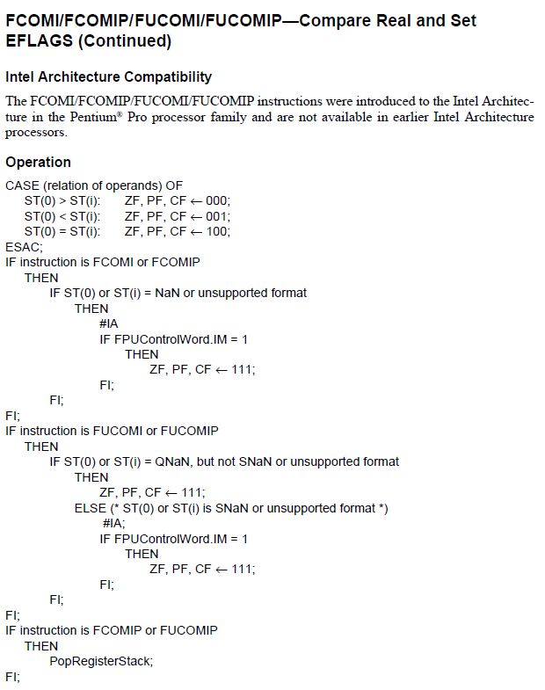
Notes:
For me, the need to devise a way to automate abstract interpretation really hit home in about 2005, after I had spent a few years working on analyzing low-level assembly and machine code. Gogul Balakrishnan and I were working with the Intel x86 instruction set, which has several hundred instructions, and Gogul was implementing numerous separate analyses. For each analysis, he went back to the 5-inch-thick manual to look at the semantics of each instruction, and then implemented an appropriate abstract transformer. This approach was both ad hoc and error-prone – but we didn’t have a better approach at the time.

Slide 12

Notes:
The desirability of automating program analysis really hit home with me after a few years working on program analysis for machine code.
In 2006, we began to work on the TSL system for creating machine-code analyses directly from a specification of the instruction-set semantics and the abstract domain on which an analysis was based. However, that is the subject of a different talk . . .

Slide 13
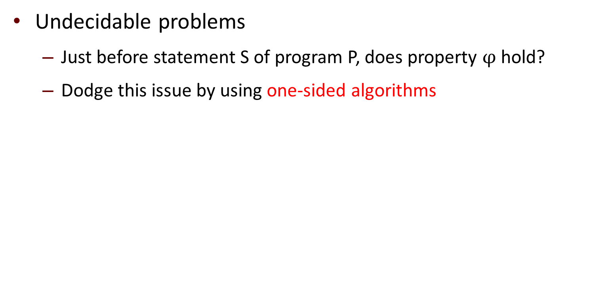
Why is Program Analysis Difficult?
Undecidable problems
Just before statement S of program P, does property $φ$ hold?
Dodge this issue by using one-sided algorithms
Notes:
The first question we should ask is “Why is automating abstract interpretation difficult?” One of the issues is that program-analysis itself is difficult, so it is worth reflecting a bit on the sources of those difficulties. A basic issues is that we are trying to solve undecidable problems: determining whether a program is correct is undecidable, in general, even when “correct” means something as simple as “contains no division-by-0 errors”. Program-analysis and verification tools sidestep the issue of undecidability by using one-sided algorithms.

Slide 14
Sidestepping Undecidability
Reachable States
Bad States
Universe of States

Slide 15
Sidestepping Undecidability
Overapproximate the reachable states
Reachable States
Bad States
False positive!
Universe of States
Notes:
. . . which can be portrayed as I’ve shown here.

Slide 16
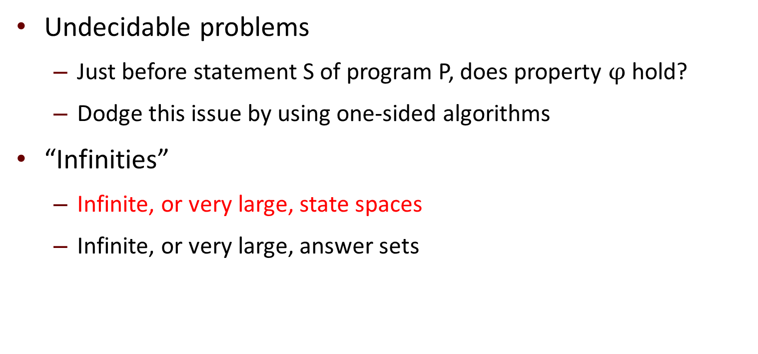
Why is Program Analysis Difficult?
Undecidable problems
Just before statement S of program P, does property $φ$ hold?
Dodge this issue by using one-sided algorithms
“Infinities”
Infinite, or very large, state spaces
Infinite, or very large, answer sets
Notes:
There are other difficulties, which might be summarized under the slogan “infinities”. By this, I mean that programs have either infinite, or at least enormous, state spaces – so program analysis is really a search in a very large, and possibly infinite, search space

Slide 17
Why is Program Analysis Difficult?
∞
Large/unbounded base types: int, float, string
User-defined types/classes
Pointers/aliasing + unbounded #’s of heap-allocated cells
Procedure calls/recursion/calls through pointers/dynamic method lookup/overloading
Concurrency + unbounded #’s of threads
Notes:
Some of the issues are listed on this slide:
o the data types used, both from the programming language and user-defined
o pointers
o procedures
o concurrency

Slide 18
Sources of Infinity
∞
Data
unbounded counters, integer variables, lists, queues
Control structures
procedures, process creation
Configuration parameters
unbounded number of processes, principals
Real-time
discrete or continuous time
Notes:
. . . and the list goes on and on: issues having to do with data, control structures, configuration parameters, etc.
Each of these issues typically requires a different approach to analysis.
Partly as a result of these issues, program analysis has a reputation of being a kind of ``black art,'' and difficult to work with.

Slide 19
Some Successes of the Field
Static Driver Verifier, a.k.a. SLAM (Microsoft)
Tool for finding possible bugs in Windows device drivers
Complicated back-out protocols in driver APIs when events cancelled or interrupted
Astrée (ENS)
Established the absence of run-time errors in Airbus flight software
Notes:
Nevertheless, the field has had a number of successes, and I’ve listed here two of the most well-known successful tools: the Static Driver Verifier from Microsoft, which allows driver developers to vet their code for certain kinds of tricky bugs that can arise, such as not performing operations in the correct order when it is necessary to back out after a driver event is cancelled or interrupted.
The Astrée system was developed to vet Airbus flight software for run-time errors.
In a way, Astrée serves as motivation for the material in this talk. Because it took a team of highly skilled graduate students from the elite Ecole Normale Superieure in Paris to build Astrée, I like to say, “Astrée scales linearly in the number of ENS graduate students on the project.”

Slide 20
Outline
Gentle introduction to abstract interpretation
First glimmer of insight
Second insight
Third insight
DiSSolve: A parallel SAT solver
Wrap-up
Notes:
In the remainder of the talk, here is what I hope to cover:
First, a brief introduction to abstract interpretation, the fundamental theory behind program analysis.
Then I want to walk you through the progression of insights that lie behind the connections mentioned a moment ago.
If there is time, I’ll then show how some of these ideas motivated the work we’ve been doing on creating a parallel SAT solver

Slide 21
Example: Parity Analysis
f (a,b) = (16 * b + 3) * (2 * a + 1)
*
+
+
*
3
*
1
16
b
2
a
+ | 0 | 1 | 2 | 3 | . . .
0 | 0 | 1 | 2 | 3 | . . .
1 | 1 | 2 | 3 | 4 | . . .
2 | 2 | 3 | 4 | 5 | . . .
3 | 3 | 4 | 5 | 6 | . . .
⋮ | ⋮ | ⋮ | ⋮ | ⋮ | ⋱
* | 0 | 1 | 2 | 3 | . . .
0 | 0 | 0 | 0 | 0 | . . .
1 | 0 | 1 | 2 | 3 | . . .
2 | 0 | 2 | 4 | 6 | . . .
3 | 0 | 3 | 6 | 9 | . . .
⋮ | ⋮ | ⋮ | ⋮ | ⋮ | ⋱
Notes:
For a simple example, consider the expression over a and b shown here.
The concrete semantics is given in terms of the standard, arithmetic interpretation of the addition and multiplication operators.

Slide 22

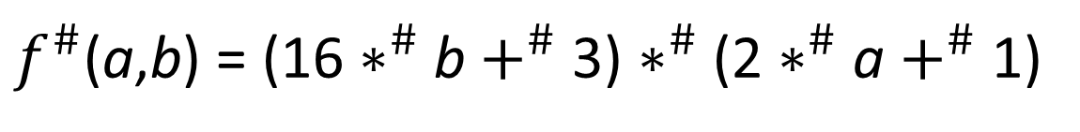
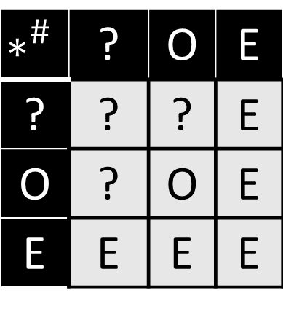
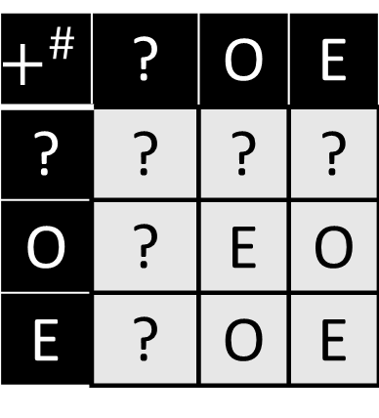
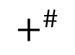
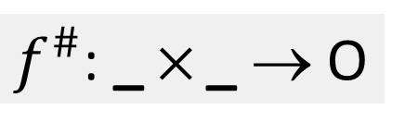
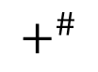


Example: Parity Analysis
$f^{\#}$(a,b) = (16 $∗^{\#}$ b $+^{\#}$ 3) $∗^{\#}$ (2 $∗^{\#}$ a $+^{\#}$ 1)
O
$$∗^{\#}$$
O
O
$$+^{\#}$$
$$+^{\#}$$
E
O
E
O
$$∗^{\#}$$
3
$$∗^{\#}$$
1
E
?
E
?
16
b
2
a
$$+^{\#}$$ | ? | O | E
? | ? | ? | ?
O | ? | E | O
E | ? | O | E
$$∗^{\#}$$ | ? | O | E
? | ? | ? | E
O | ? | O | E
E | E | E | E
$f^{\#}$: _  _ → O
Notes:
To analyze the expression with respect to parity, we use an alternative interpretation of the operators that uses just three values: O (for “odd”), E (for “even”), and ? (for “unknown”).
<Explain slide>

Slide 23
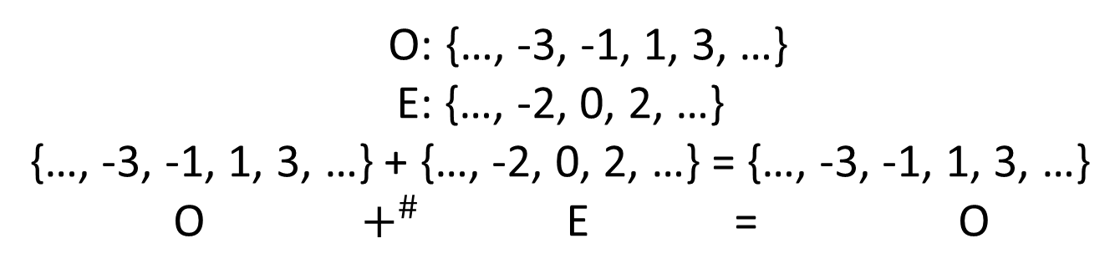
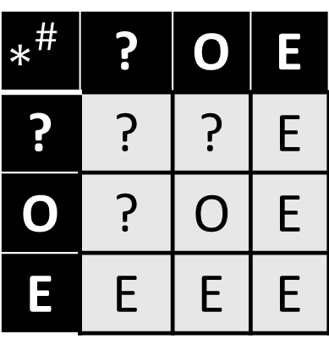
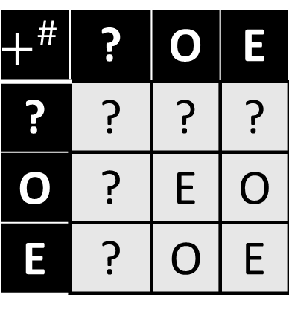
Abstract values, such as O, E, and ?, represent potentially infinite collections of concrete values
O: {…, -3, -1, 1, 3, …}
E: {…, -2, 0, 2, …}
{…, -3, -1, 1, 3, …} + {…, -2, 0, 2, …} = {…, -3, -1, 1, 3, …}
O $+^{\#}$ E = O
$$+^{\#}$$ | ? | O | E
? | ? | ? | ?
O | ? | E | O
E | ? | O | E
$$∗^{\#}$$ | ? | O | E
? | ? | ? | E
O | ? | O | E
E | E | E | E
Notes:
This approach actually provides a way to automate abstract interpretation. Essentially, for every operator in the programming language, you provide an abstract counterpart and use these to evaluate your program. But, as we’ll see in a few slides, this method has some drawbacks.

Slide 24
Constant Propagation
i = 0
[i  ?, j  ?]
λe.e[i  0]
[i  0, j  ?]
j = 0
λe.e[j  0]
[i  0, j  0]
 [i  1, j  0]
while i ≤ 2
λe.e
λe.e
[i  0, j  0]
j = (j+1)/4
λe.e[j  (e(j)+1)/4]
[i  0, j  0]
i = i+1
λe.e[i  e(i) + 1]
[i  0, j  0]
printf(i,j)
Notes:
The previous example was at the level of individual expressions. A similar thing goes on at the level of control-flow graphs, although here the abstract values propagate through the graph, and because of cycles you may have to visit nodes multiple times before the abstract values quiesce.

Slide 25
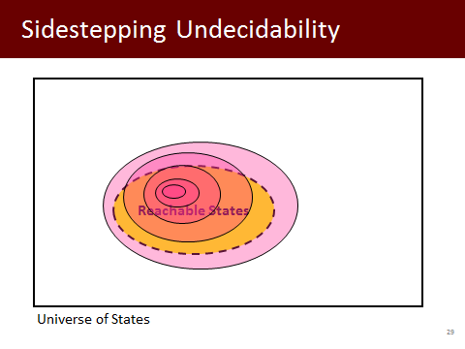
Constant Propagation
i = 0
[i  ?, j  ?]
λe.e[i  0]
[i  0, j  ?]
j = 0
λe.e[j  0]
[i  ?, j  0]
 [i  ?, j  0]
while (…)
λe.e
λe.e
[i  0, j  0]
[i  ?, j  0]
j = (j+1)/4
i ∈ {…,-2,-1,0,1,2, …}
j ∈ {0}
λe.e[j  (e(j)+1)/4]
[i  0, j  0]
[i  ?, j  0]
i = i+1
λe.e[i  e(i) + 1]
[i  0, j  0]
[i  ?, j  0]
printf(i,j)
Notes:
When the analysis is done, what we’ve learned is that j must be 0, but we know nothing about the value of i.
By the way, when I showed this slide about state-space exploration a few minutes ago, it was an abstract portrayal of this process of successive approximation.

Slide 26
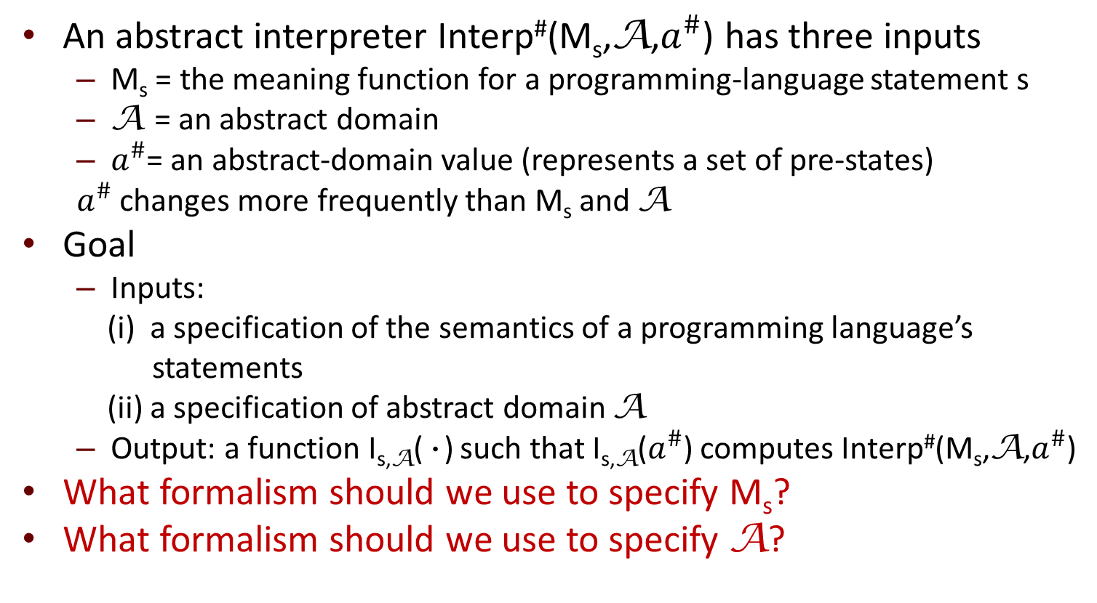
What Does It Mean to Automate Abstract Interpretation?
An abstract interpreter Interp#(M_{s},A,$a^{\#}$) has three inputs
M_{s} = the meaning function for a programming-language statement s
A = an abstract domain
$a^{\#}$= an abstract-domain value (represents a set of pre-states)
$a^{\#}$ changes more frequently than M_{s} and A
Goal
Inputs:
(i) a specification of the semantics of a programming language’s
statements
(ii) a specification of abstract domain A
Output: a function I_{s,A}(•) such that I_{s,A}($a^{\#}$) computes Interp#(M_{s},A,$a^{\#}$)
What formalism should we use to specify M_{s}?
What formalism should we use to specify A?
Notes:
We can now return to the question of what it means to automate abstract interpretation.
<READ SLIDE>

Slide 27


Abstract Interpretation [CC77]
{(2,1), (2,2), (2,3),
(3,1), (3,2), (3,3),
(4,1), (4,2), (4,3),
(5,1), (5,2), (5,3)}
{(x→2, y→1),
(x→5, y→3)}
x → [2,5]
y → [1,3]
γ
α
α
Universe of States
Patrick
Cousot
Radhia
Cousot
Notes:
Abstract interpretation is the beautiful theory formulated by Patrick and Radhia Cousot, which links a concrete domain of facts or states with an abstraction

Slide 28
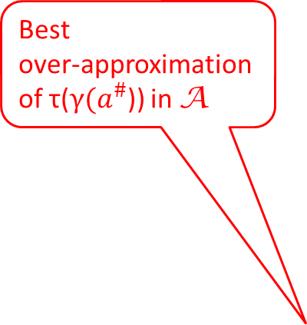
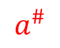
Best Transformer [CC79]
However, no algorithms to
apply the best transformer ☹
create the best transformer ☹
Best
over-approximation
of τ(γ($a^{\#}$)) in A
Loss of precision
γ
α
τ
τ
τ
safe τ#
τ
τ
τ
τ
γ
τ#
$$a^{\#}$$
Universe of States
Patrick
Cousot
Radhia
Cousot
Notes:
One aspect of their theory is that once you’ve fixed on an abstract domain, there is a limit on the precision you can achieve.
One of the places where this comes up is with the concept of the “best transformer”
<Explain slide>
This idea provides a theoretical bound on the achievable precision, but until recently there had been little work on algorithms that are capable of achieving these limits – for instance, for applying the best transformer, or for creating a representation of the best-transformer function

Slide 29
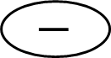

Challenge: Abstract Interpretation is Inherently Non-Compositional
[-5,5]
$$+$$
[5,10]
[-10,-5]
x
$$−$$
In computer science, we rely on compositionality
languages are expressed using context-free grammars
many concepts and properties defined using inductive definitions
recursive tree traversals are a basic workhorse
software organized into layers
Example: (x + (–x)), evaluated in (x ↦ [5,10], y ↦ [10,20])
[-5, 5] versus [0,0]
In general
Suppose that you have in hand a collection of ``best” abstract-interpretation operators
Their composition may not provide the best (abstract) answer for the composition of the corresponding concrete operations
[5,10]
x
Notes:
Unfortunately, abstract interpretation has the drawback that it is non-compositional -- which runs counter to one of the major tools that one uses in computer science: programs are written to compose;
software is organized into layers; languages are expressed using grammars; etc.
Abstract interpretation is non-compositional in the following sense: For a given choice of “abstract domain” that one works with, there is a limit to the precision that an analyzer using that abstract domain can achieve; however, even if you have in hand a collection of “best” abstract-interpretation operators, their composition may not provide the best (abstract) answer for the composition of the corresponding concrete operations.
Ideally, a method to automate abstract interpretation will give a grip on the non-compositionality issue, as well.

Slide 30
Automating Abstraction Interpretation
Q1. What formalism is used to specify M_{s}?
Q2. What formalism is used to specify A?
Q3. What is the engine at work that applies/constructs abstract transformers?
(a) What method is used to create I_{s,A}(·)?
(b) Can it be used to create a representation of I_{s,A}(·)?
Q4. How is the non-compositionality issue addressed?
Abstract interpretation
A “black art” → hard to work with
20-year quest to raise the level of automation in abstract interpretation
3-valued logic analysis (TVLA)
with M. Sagiv, R. Wilhelm, T. Lev-Ami, A. Loginov, & many others
machine-code analysis (TSL)
with J. Lim
symbolic-abstraction algorithms
with M. Sagiv, G. Yorsh, A. Thakur
Reps, T. and Thakur, A., “Automating abstract
interpretation,” VMCAI, 2016.
research.cs.wisc.edu/wpis/papers/vmcai16-invited.pdf
Patrick
Cousot
Radhia
Cousot
Notes:
With that background, let me just point out one thing about the paper in the proceedings. We attempted to unify the discussion by identifying four questions, and we give summaries of the various efforts by giving answers to the four questions. In particular,
Q1: What formalism is used for specifying the concrete semantics?
Q2: What formalism is used for specifying the abstract domain?
Q3: What is the engine or principle that is used to apply or construct an abstract transformer automatically?
Q4: How is non-compositionality addressed?

Slide 31
Outline
Gentle introduction to abstract interpretation
First glimmer of insight
Second insight
Third insight
DiSSolve: A parallel SAT solver
Wrap-up
Notes:
The rest of the talk will be about work that my students, collaborators, and I have done over the last dozen years.

Slide 32
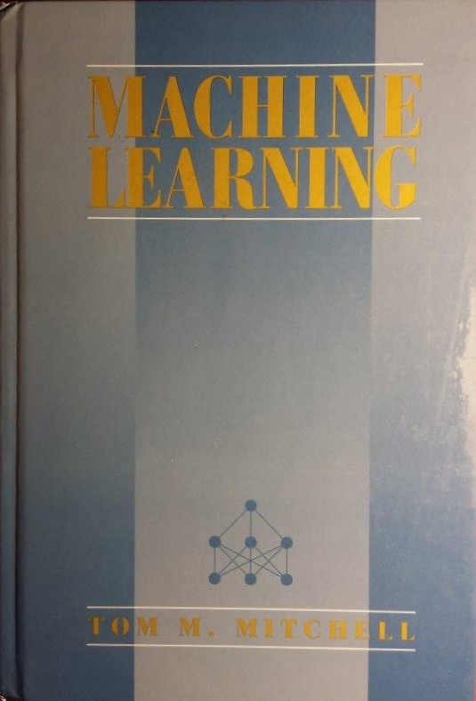
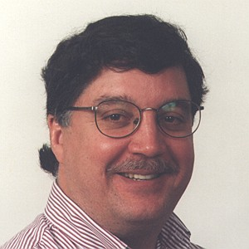


A First Glimmer
40% of the people in the Wisconsin CS department are doing machine learning, but don’t know it
Jude Shavlik
R., Sagiv, & Yorsh: Symbolic implementation
of the best transformer, VMCAI 2004
Mooly
Sagiv
Greta
Yorsh
Notes:
The first glimmer of insight – although I didn’t know it at the time – came from a conversation with a colleague of mine at Wisconsin, Jude Shavlik, who is well-known in the area of Machine Learning. Jude used to like to be controversial, and would say things like <read slide>.
In September 2002, just before flying off to a conference in Madrid, I said I wanted to understand his remark better, and asked him what I should read. He gave me a copy of Tom Mitchell’s book on Machine Learning, which had come out a few years before. We’ll see shortly how this turned out to be related to work that Mooly Sagiv, Greta Yorsh, and I did on harnessing logic to automate abstract interpretation.

Slide 33
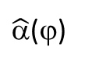
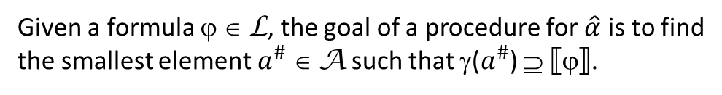
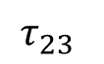
Symbolic Abstraction
(x ↦ [5, 10]) ⇝ 5 ≤ x ˄ x ≤ 10
Interval ⇝ conjunction of
environment single-variable
inequalities
γ
←→
ϕ
$$\hat{\text{α}}$$
$\hat{\text{α}}$(ϕ)
States
L
A
Given a formula ϕ ∈ L, the goal of a procedure for $\hat{α}$ is to find
the smallest element $a^{\#}$ ∈ A such that γ($a^{\#}$) ⊇ ←ϕ→.
Typically, L is a rich language and A is an impoverished logic fragment L'.
Symbolic abstraction addresses a fundamental approximation problem:
Given ϕ ∈ L, find the strongest consequence of ϕ that is expressible in L'.
Notes:
In an earlier slide, I showed you two spaces of values – the concrete states and the abstract domain – which is how abstract interpretation is often presented. One thing Mooly, Greta, and I did was to introduce a third space of values, namely a logical language L. The reason one wants the space L is because that is what you need for describing the semantics of a program; the semantics is often richer than what you need in the abstract domain.

Slide 34
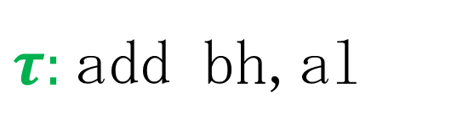

Example
$τ:$add bh,al
Adds al, the low-order byte of 32-bit register eax,to bh, the second-to-lowest byte of 32-bit register ebx
eax
$$+$$
ebx
Notes:
Let’s look at an example from the 32-bit x86 instruction set

Slide 35
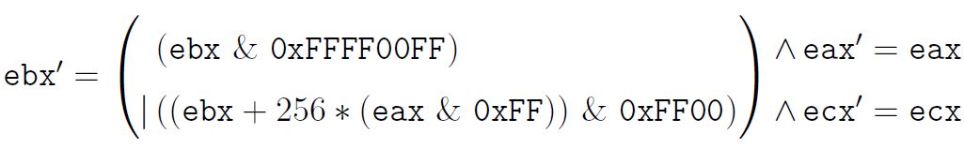
From concrete semantics to formulas
Bitvector-and [with constant] may not be an operator in the impoverished logic of the abstract domain
$τ:$add bh,al
Bitvector-or may not be an operator in the impoverished logic of the abstract domain
Multiplication [by constant] may not be an operator in the impoverished logic of the abstract domain
Primed variables represent values
in the post-state
Notes:
<Explain slide>
One reason I like this example is that it shows clearly that the core issue in symbolic abstraction and creation of abstract transformers is finding strongest consequence in a different logic fragment.

Slide 36
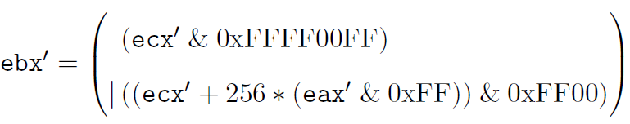
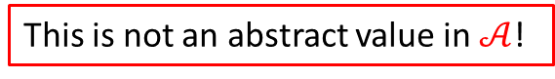
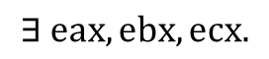
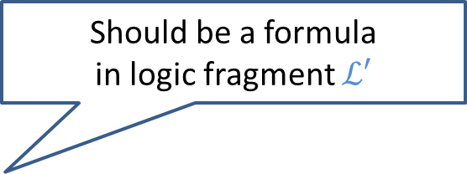

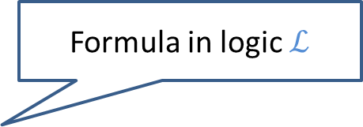
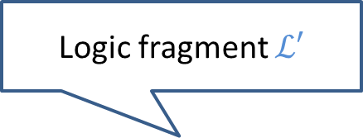

Abstract Transformer via Quantifier Elimination?
Logic fragment $ℒ′$
$𝒜$: Conjunctions of bit-vector affine equalities between registers
Formula in logic $ℒ$
$$∃ eax,ebx, ecx.$$
ebx $=$ ecx
$$∧$$
Should be a formula in logic fragment $ℒ′$
Eliminate unprimed registers
This is not an abstract value in $𝒜$!
Notes:
One common point of confusion about this topic is to think that the core issue is quantifier elimination. That is only the case for the restricted situation where the logic fragment of the abstract domain is the same as the logic fragment that you use for specifying the concrete semantics.
The complex semantics of machine-code instructions shows that to really capture concrete semantics, you need to use a much richer logic for the concrete semantics than for the abstract domain. Take the case of affine-relation analysis, where the logic fragment of the abstract domain is conjunctions of linear equalities. Suppose you know that register ebx equals ecx in the pre-state, and you perform quantifier elimination. You start with a formula in quantifier-free bit-vector arithmetic, and what you end up with is still a formula in quantifier-free bit-vector arithmetic. You don’t end up with an abstract-domain element.

Slide 37
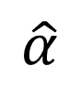
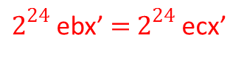
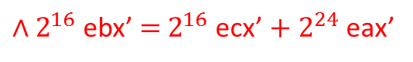
Best Transformer via Symbolic Abstraction
$𝒜$: Conjunctions of bit-vector affine equalities between registers
ebx $=$ ecx
$$∧$$
$$\hat{α}$$
$2^{24}$ebx’ $=$ $2^{24}$ecx’
$∧2^{16}$ebx’ $=$ $2^{16}$ecx’ $+ 2^{24}$eax’
Notes:
In contrast, consider the answer produced using symbolic abstraction

Slide 38
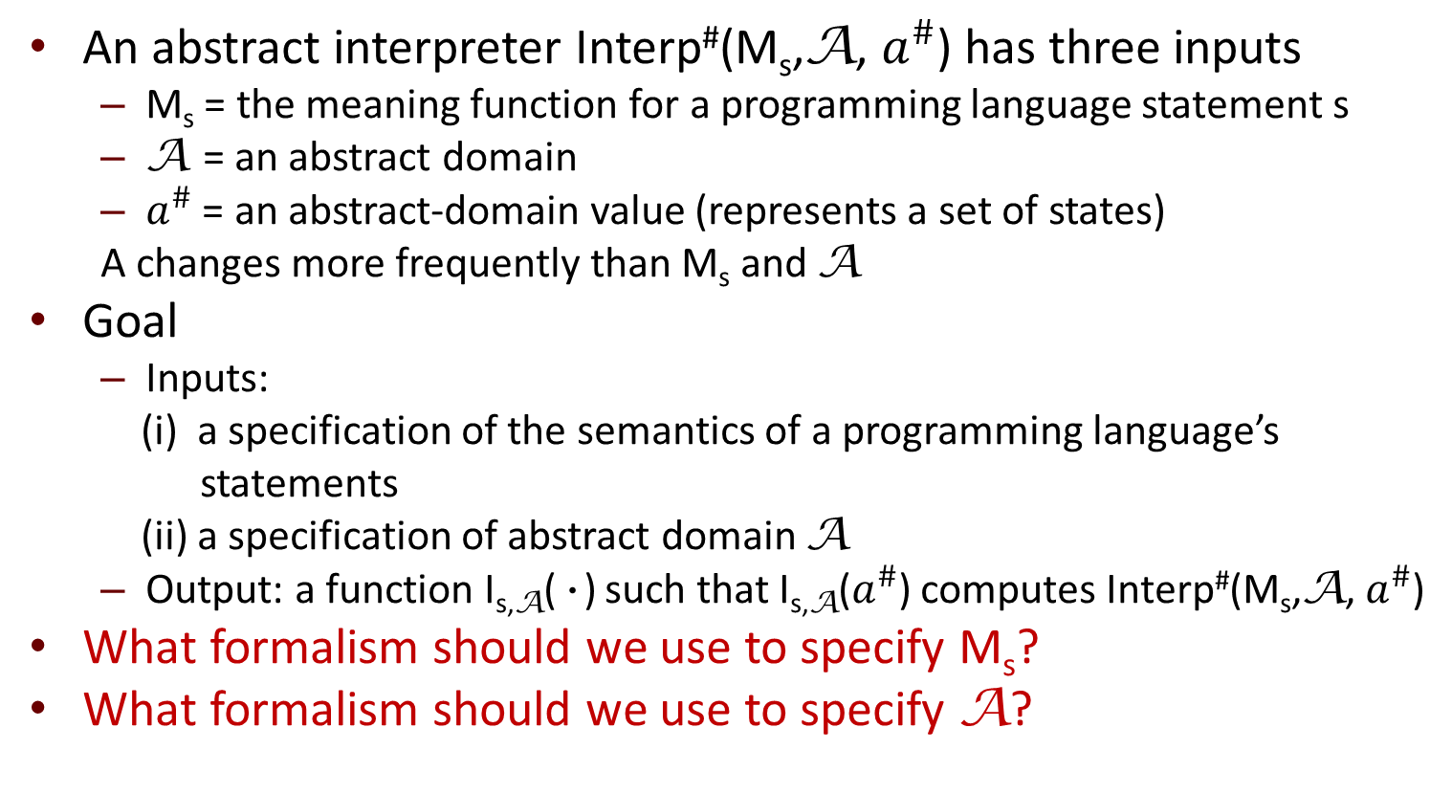
What Does It Mean to Automate Abstract Interpretation?
An abstract interpreter Interp#(M_{s},A, $a^{\#}$) has three inputs
M_{s} = the meaning function for a programming language statement s
A = an abstract domain
$a^{\#}$ = an abstract-domain value (represents a set of states)
A changes more frequently than M_{s} and A
Goal
Inputs:
(i) a specification of the semantics of a programming language’s
statements
(ii) a specification of abstract domain A
Output: a function I_{s,A}(•) such that I_{s,A}($a^{\#}$) computes Interp#(M_{s},A, $a^{\#}$)
What formalism should we use to specify M_{s}?
What formalism should we use to specify A?
Use logic, such as quantifier-free bit-vector arithmetic (QF_ABV)

Slide 39


The Idea Behind Procedure $\hat{α}\left(\text{ϕ}\right)$
ϕ
$$a^{\#}$$
←ϕ→
γ
C
L
A
Notes:
Let’s go back to 2002, and discuss the first procedure that we found for symbolic abstraction.

Slide 40

The Idea Behind Procedure $\hat{α}\left(\text{ϕ}\right)$
ϕ
S  ϕ
β(S)
S
$$a^{\#}$$
←ϕ→
β
C
L
A
Notes:
Our method was a successive-approximation method. Initially, the candidate answer is set to the least element of the abstract domain.

Slide 41




The Idea Behind Procedure $\hat{α}\left(\text{ϕ}\right)$
ϕ
←ϕ ∧ ¬$\hat{γ}(a^{\#})$→
S  ϕ
$$\hat{γ}$$
β(S)
$$\hat{γ}(a)$$
S
$$a^{\#}$$
←ϕ→
β
←$\hat{γ}(a)$→
C
L
A

Slide 42

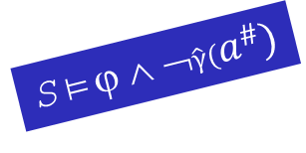
The Idea Behind Procedure $\hat{α}\left(\text{ϕ}\right)$
ϕ
←ϕ ∧ ¬$\hat{γ}(a^{\#})$→
S  ϕ ∧ ¬$\hat{γ}(a^{\#})$
$$\hat{γ}$$
β(S)
S
←ϕ→
$$\hat{γ}(a^{\#})$$
$$a^{\#}$$
β
C
L
A

Slide 43




The Idea Behind Procedure $\hat{α}\left(\text{ϕ}\right)$
ϕ
←ϕ ∧ ¬$\hat{γ}(a^{\#})$→
$$\hat{γ}$$
β(S)
S
$$\hat{γ}(a^{\#})$$
←ϕ→
$$a^{\#}$$
β
←$\hat{γ}(a^{\#})$→
C
L
A

Slide 44
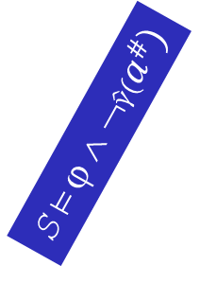



The Idea Behind Procedure $\hat{α}\left(\text{ϕ}\right)$
γ
ϕ
$$\hat{γ}$$
←$\hat{γ}(a^{\#})$→, γ($a^{\#}$)
$$\hat{γ}(a^{\#})$$
S  ϕ ∧ ¬$\hat{γ}(a^{\#})$
$$a^{\#}$$
unsat
C
L
A

Slide 45


Procedure $\hat{α}$
$\hat{α}$(formula ψ) {
$a^{\#}$ := ⊥
ϕ := ψ
while (ϕ ∧ ¬$\hat{γ}(a^{\#})$is satisfiable) {
Select a store S such that S  ϕ ∧ ¬$\hat{γ}(a^{\#})$
$a^{\#}$ := $a^{\#}$  β(S)
}
return $a^{\#}$
}
R., Sagiv, & Yorsh: Symbolic implementation
of the best transformer, VMCAI 2004
Mooly
Sagiv
Greta
Yorsh
Notes:
The algorithm is extremely simple – basically it can be stated in seven lines

Slide 46

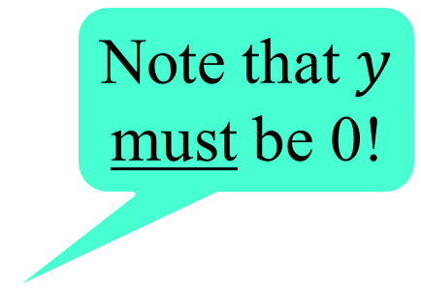

Example: $\hat{α}$_{CP}($y=x+(−x)$)
Note that $y$
must be 0!
Initialization:
$a^{\#}$ := ⊥
ϕ := ($y=x+(−x)$)
Iteration 1: S := [x → 43, y → 0] // A satisfying store
$a^{\#}$ := ⊥  β ([x → 43, y → 0])
= [x→43, y→0]
$\hat{γ}$($a^{\#}$) = (x = 43) ∧ (y = 0)
ϕ := ($y=x+(−x)$) ∧ ¬((x = 43) ∧ (y = 0))
Notes:
Just to make it more concrete, let’s work through a specific example for constant-propagation analysis.

Slide 47


Procedure $\hat{α}$_{CP}(ϕ)
$$y=x+(−x)$$

[x→43,
y→0]
S
$$a^{\#}$$
β
[x→43,y→0]
Concrete
Values
Formulas
Abstract
Values

Slide 48

Procedure $\hat{α}$_{CP}(ϕ)
$$y=x+(−x)$$

(x = 43)
∧ (y = 0)
[x→43,
y→0]
$$\hat{γ}$$
S
$$a^{\#}$$
β
[x→43,y→0]
Concrete
Values
Formulas
Abstract
Values

Slide 49

Procedure $\hat{α}$_{CP}(ϕ)
$$(y=x+\left(−x\right))$$
∧ ¬((x = 43) ∧ (y = 0))
[x→43,
y→0]
$$a^{\#}$$
Concrete
Values
Formulas
Abstract
Values

Slide 50

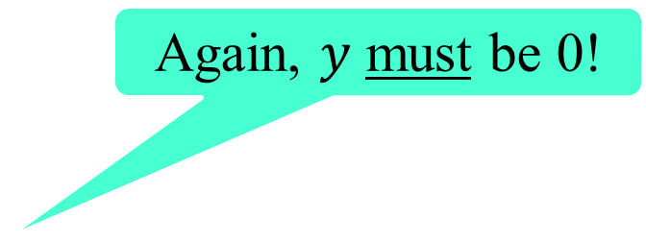
Example: $\hat{α}$_{CP}($y=x+(−x)$)
Again, $y$ must be 0!
. . .
$a^{\#}$ := [x→43, y→0]
ϕ = $(y=x+\left(−x\right))$ ∧ ¬((x = 43) ∧ (y = 0))
Iteration 2: S := [x→46,y→0] // A satisfying store
$a^{\#}$ := [x→43,y→0]  β ([x→46,y→0])
= [x→43, y→0]  [x→46,y→0]
= [x→T, y→0]
$\hat{γ}$($a^{\#}$) = (y = 0)
ϕ := $(y=x+\left(−x\right))$ ∧ ¬(y = 0)
Iteration 3: ϕ is unsatisfiable
Return value: [x→T, y→0]

Slide 51
Procedure $\hat{α}$_{CP}(ϕ)
$$(y=x+\left(−x\right))$$
∧ ¬((x = 43) ∧ (y = 0))

[x→46,
y→0]
S
[x→43,
y→0]
β
[x→46,y→0]
Concrete
Values
Formulas
Abstract
Values

Slide 52


Procedure $\hat{α}$_{CP}(ϕ)
$$(y=x+\left(−x\right))$$
∧ ¬((x = 43) ∧ (y = 0))

[x→T, y→0]
$$\hat{γ}$$
S
(y = 0)
$$a^{\#}$$
β
[x→46,y→0]
Concrete
Values
Formulas
Abstract
Values

Slide 53
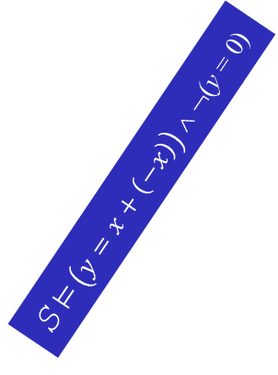


Procedure $\hat{α}$_{CP}(ϕ)
←$\left(y=x+\left(−x\right)\right)$→
$$\left(y=x+\left(−x\right)\right)$$
∧ ¬(y = 0)
[x→T, y→0]
S  $\left(y=x+\left(−x\right)\right)$ ∧ ¬(y = 0)
$$a^{\#}$$
γ
unsat
Concrete
Values
Formulas
Abstract
Values

Slide 54
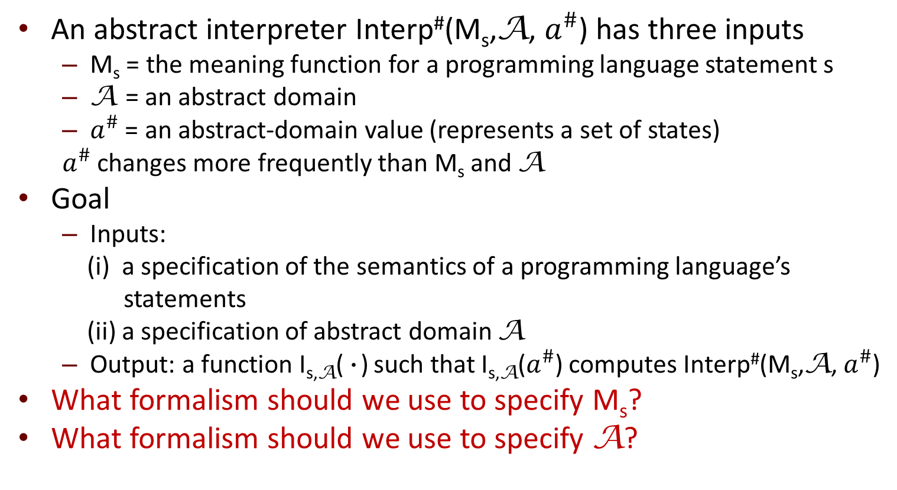
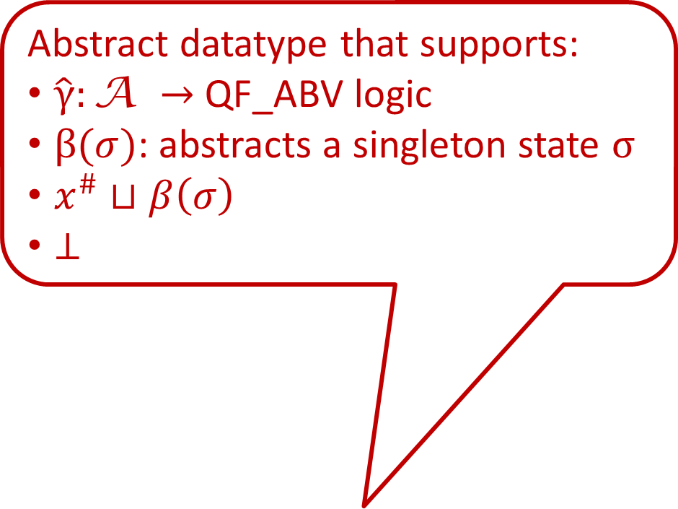
What Does It Mean to Automate Abstract Interpretation?
Abstract datatype that supports:
$\hat{γ}:\text{A} →$ QF_ABV logic
$β(σ)$: abstracts a singleton state $σ$
$x^{\#}$ $⊔β\left(σ\right)$
$⊥$
An abstract interpreter Interp#(M_{s},A, $a^{\#}$) has three inputs
M_{s} = the meaning function for a programming language statement s
A = an abstract domain
$a^{\#}$ = an abstract-domain value (represents a set of states)
$a^{\#}$ changes more frequently than M_{s} and A
Goal
Inputs:
(i) a specification of the semantics of a programming language’s
statements
(ii) a specification of abstract domain A
Output: a function I_{s,A}(•) such that I_{s,A}($a^{\#}$) computes Interp#(M_{s},A, $a^{\#}$)
What formalism should we use to specify M_{s}?
What formalism should we use to specify A?
Notes:
We can now answer the question about the second formalism that we need for automating abstract interpretation.
Basically, we need our space of abstract values to be equipped with a few operations listed here, which were used by the alphaHat procedure.

Slide 55
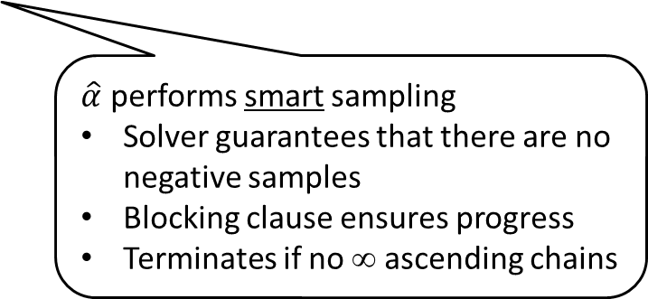
A First Glimmer
40% of the people in the Wisconsin CS department are doing machine learning, but don’t know it
Find-S Algorithm for learning a concept in a concept lattice:
Discard all negative examples
Return the join of all positive examples
Jude Shavlik
$\hat{α}$ performs smart sampling
Solver guarantees that there are no negative samples
Blocking clause ensures progress
Terminates if no ∞ ascending chains
Notes:
I said that the first glimmer came in September 2002 when I took Mitchell’s machine-learning book with me when I went to a conference in Madrid. While I was there, Mooly and I realized that the procedure I just described could be used to perform symbolic abstraction for certain logics and certain domains.
On the flight home, I cracked open the Mitchell book, and discovered an interesting thing. Our symbolic-abstraction procedure had strong connections with the Find-S algorithm in Chapter 2, which had been part of Mitchell’s own PhD thesis. <See slide>

Slide 56
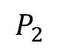
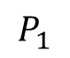
Symbolic Abstraction
γ
←→
ϕ
$$\hat{\text{α}}$$
$\hat{\text{α}}$(ϕ)
Connections with machine learning: find the strongest concept that describes $φ$
States
L
A
Given a formula ϕ ∈ L, the goal of a procedure for $\hat{α}$ is to find
the smallest element A ∈ A such that γ(A) ⊇ ←ϕ→.
Typically, L is a rich language and A is an impoverished logic fragment L'.
Symbolic abstraction addresses a fundamental approximation problem:
Given ϕ ∈ L, find the strongest consequence of ϕ that is expressible in L'.
Notes:
machine learning: strongest concept that describes phi
concept lattice -- abstract domain
inductive bias -- impoverished logic fragment

Slide 57
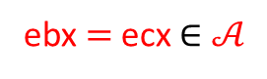
Abstract Transformer via Quantifier Elimination?
$𝒜$: Conjunctions of bit-vector affine equalities between registers
ebx $=$ ecx $∈𝒜$
Notes:
Now Gulwani and Tiwari’s papers emphasized the importance of quantifier elimination,
but that is an incomplete account of the issues, as we can see if we perform quantifier
elimination in our example

Slide 58

The Story in a Nutshell
It’s all symbolic abstraction!
Program analyzers
constructing transformers for equation system
use multiple analyzers: ($a_{1}^{\#}$, $a_{2}^{\#}$) ∈ A₁ x A₂; use $a_{1}^{\#}$ to improve $a_{2}^{\#}$and vice versa
heterogeneous abstraction: need to convert from $a_{1}^{\#}$ ∈ A₁ to $a_{2}^{\#}$ ∈ A₂ at borders
Solvers
unsat checking reduces to symbolic abstraction
We now know multiple algorithms for computing $\hat{α}$
Notes:
When I have to present my work to funding agencies, I summarize things
this way: the story in a nutshell is that it is all symbolic abstraction. Basically, most of the
key operations that one might use in a static analyzer can be captured as varients
of the symbolic-abstraction operation.
Moreover, we now have algorithms for performing symbolic abstraction, one of which I’ve
already shown to you.

Slide 59









Reduced Product
$\hat{γ}$₁
$\hat{γ}$₁($a_{1}^{\#}$)∧ $\hat{γ}$₂($a_{2}^{\#}$)
$\hat{γ}$₂
$$a_{1}^{\#}$$
$$a_{2}^{\#}$$
$$a_{1}^{\#′}$$
$\hat{α}$₁
$\hat{α}$₂
$$a_{2}^{\#′}$$
A₁
L
A₂
Notes:
reduced-product

Slide 60




Reduced Product
3 ≤ a ≤ 12
5 ≤ b ≤ 10
7 ≤ c ≤ 7
2³¹ a = 0
2³¹ b = 2³¹
(aeven,
bodd,
cΤ)
$\hat{γ}$_{P}
$\hat{γ}$_{I}
(a[3,12],
b[5,10],
c[7,7])
(aeven,
bodd,
codd)
$\hat{α}$_{P}
$\hat{α}$_{I}
(a[4,12],
b[5,9],
c[7,7])
Parity
L
Interval
Notes:
reduced-product-example

Slide 61





Reduced Product: Clique Approach
A₁
$$a_{1}^{\#}$$
$$a_{5}^{\#}$$
$$a_{2}^{\#}$$
A₂
A₅
$$a_{4}^{\#}$$
$$a_{3}^{\#}$$
A₄
A₃
Notes:
clique-approach

Slide 62






Reduced Product: Clique Approach
A₁
$$a_{1}^{\#}$$
$$a_{5}^{\#}$$
A₅
$$a_{2}^{\#}$$
A₂
A
$$a^{\#}$$
$$a_{4}^{\#}$$
$$a_{3}^{\#}$$
A₄
A₃
Notes:
clique-approach-new-element

Slide 63





Reduced Product: Symb. Abs. Approach
A₁
$$a_{1}^{\#}$$
$$a_{5}^{\#}$$
$$a_{2}^{\#}$$
A₂
A₅
L
$$a_{4}^{\#}$$
$$a_{3}^{\#}$$
A₄
A₃
Notes:
uncol-approach

Slide 64






Reduced Product: Symb. Abs. Approach
A₁
$$a_{1}^{\#}$$
$$a_{5}^{\#}$$
A₅
$$a_{2}^{\#}$$
A₂
L
A
$$a^{\#}$$
$$a_{4}^{\#}$$
$$a_{3}^{\#}$$
A₄
A₃
Notes:
uncol-approach-new-element

Slide 65
Connections, Connections, . . .
Automated reasoning/decision procedures
Machine learning
Knowledge compilation
Consequence finding
Data integration
Constraint programming

Slide 66


The Story in a Nutshell
It’s all symbolic abstraction!
Program analyzers
constructing transformers for equation system
use multiple analyzers: ($a_{1}^{\#}$, $a_{2}^{\#}$) ∈ A₁ x A₂; use $a_{1}^{\#}$ to improve $a_{2}^{\#}$ and vice versa
heterogeneous abstraction: need to convert from $a_{1}^{\#}$ ∈ A₁ to $a_{2}^{\#}$∈ A₂ at borders
Solvers
unsat checking reduces to symbolic abstraction
We now know multiple algorithms for performing $\hat{α}$
$a_{2}^{\#}$= $\hat{α}2(\hat{γ}1(a_{1}^{\#}))$

Slide 67

The Story in a Nutshell
It’s all symbolic abstraction!
Program analyzers
constructing transformers for equation system
use multiple analyzers: ($a_{1}^{\#}$, $a_{2}^{\#}$) ∈ A₁ x A₂; use a₁ to improve a₂ and vice versa
heterogeneous abstraction: need to convert from $a_{1}^{\#}$ ∈ A₁ to $a_{2}^{\#}$ ∈ A₂ at borders
Solvers
unsat checking reduces to symbolic abstraction
We now know multiple algorithms for performing $\hat{α}$
Notes:
On the solver side, as we said earlier, unsat checking reduces to symbolic abstraction
However, I’ve gotten a little ahead of my story, because the only alphahat algorithm
I’ve shown you doesn’t apply to solvers.
Thus, I want to turn to the second glimmer of insight, which for me came in Spring 2011,
when Aditya Thakur and I encountered Staalmarck’s method.

Slide 68

Outline
Gentle introduction to abstract interpretation
First glimmer of insight
Second insight: apply Stålmarck’s method to perform $\hat{α}$
Third insight
DiSSolve: A parallel SAT solver
Wrap-up
Notes:
I want to move on to our second insight, which gave us a completely different approach to creating an algorithm for symbolic abstraction. This advance came about when my student Aditya Thakur and I started to study an old algorithm for propositional satisfiability, called Staalmarck’s method.

Slide 69




Stålmarck’s method
Propagation Rules
$$R=\{v_{1}=\text{True},v_{2}=\text{∗,}v_{3}=\text{∗\}}$$
$$v_{1}∧$$
$$v_{2}$$
$$v_{3}$$
$$R^{′}=R∪\{v_{2}=\text{True}\text{,}{ v}_{3}=\text{True}\text{\}}$$
Notes:
Staalmarck’s method has two kind of rules. The first kind, called propagation rules, are illustrated here.
Basically, there is one auxiliary variable for each node of the formulas abstract syntax tree. The variable for subtree T records the inferred truth value for subtree T. Once you know the value of some variables, you have some leverage on the value of other variables. For instance, if the variable at the root of the subtree is v1, the root is an “AND”, and the variables for the are v2 and v3, then you know that both v2 and v3 must also be true. There is no other way that v1 could be true unless that were the case.

Slide 70



Stålmarck’s method
Propagation Rules
$$R=\{v_{1}=\text{False},v_{2}=\text{∗,}v_{3}=\text{∗\}}$$
$$v_{1}∨$$
$$v_{2}$$
$$v_{3}$$
$$R^{′}=R∪\{v_{2}=\text{False}\text{,}v_{3}=\text{False}\text{\}}$$
Notes:
Similarly, if the root of the subtree is an “OR” and the known value is false, the v2 and v3 must both be false.

Slide 71


Stålmarck’s method
Propagation Rules
$$R=\{v_{1}=\text{True},v_{2}=\text{∗,}v_{3}=\text{∗\}}$$
$$v_{1}∨$$
$$v_{2}$$
$$v_{3}$$
$$R^{′}=R$$
Notes:
But in this case, when we have an OR at the root of the subtree, and v1 is true, we don’t know whether v2, v3, or both should be true.

Slide 72










Stålmarck’s method
Dilemma Rule
$$R$$
Split
$$R∪\{v=\text{True}\text{\}}$$
$$R∪\{v=\text{False}\text{\}}$$
v $=\text{True}\text{,}$
w $=\text{True}$
Propagate
v $=\text{False}\text{,}$
w $=\text{True}$
$$R_{1}^{′}∩R_{2}^{′}$$
Merge
$$R_{2}^{′}$$
$$R_{1}^{′}$$
w $=\text{True}$
Sheeran & Stålmarck, A tutorial
on Stålmarck’s proof procedure
for propositional logic, FMSD
16(1), 2000
Gunnar
Stålmarck
Notes:
So Gunnar Staalmarck introduced what he called the “Dilemma Rule”. Basically, he tries both possibilities – which is something that other satisfiability procedures do as well – but then he does something different: at the end of the two sequences in which the propagation rules are used, he merges the results by taking their intersection.
You can think of this step in terms of learning. If a fact is learned on both branches, then the intersection keeps it; otherwise, it is discarded. Of course, because the two branches made contradictory assumptions – (v = true) and (v = false) – the learned fact won’t be about v. v will always be set back to unknown by the merge. However, there may be some other variable v’ whose value is true on both sides, or v’’ whose value is false on both sides. Such assignments would be kept by the merge.

Slide 73


Stålmarck’s method
$$(v_{root}=true)$$
$φ$ is unsatisfiable
Inconsistent
Facts
Inconsistent
Facts
Notes:
Staalmarck’s method is really a method for checking unsatifiability. We start with just the one fact that v_root = true

Slide 74

Key Insight
Stålmarck

Slide 75
Key Insight
Abstract
Interpretation

Slide 76


Key Insight
Stålmarck$[𝒜]$
$𝒜$ = a Boolean abstract domain

Slide 77
Stålmarck’s method
Dilemma Rule
$$R$$
Split
$$R∪\{v=\text{True}\text{\}}$$
$$R∪\{v=\text{False}\text{\}}$$
Propagate
$$R_{1}^{′}∩R_{2}^{′}$$
Merge
$$R_{2}^{′}$$
$$R_{1}^{′}$$
Sheeran & Stålmarck, A tutorial
on Stålmarck’s proof procedure
for propositional logic, FMSD
16(1), 2000
Gunnar
Stålmarck

Slide 78

















Stålmarck[$𝒜$]: Generalized Stålmarck’s method
$$⊤$$
Dilemma Rule
$$a^{\#}$$
$${γ(a}_{1})∪{γ(a}_{2})⊇γ(a^{\#})$$
$$R$$
Split
$$R∪\{v=\text{False}\text{\}}$$
$$a^{\#}⊓a_{1}$$
$$a^{\#}⊓a_{2}$$
$$R∪\{v=\text{True}\text{\}}$$
Propagate
$$F_{1}^{′}∩F_{2}^{′}$$
$$a_{1}^{\#}′⊔a_{2}^{\#′}$$
Merge
$$F_{2}^{′}$$
$$a_{2}^{\#}′$$
$$a_{1}^{\#}′$$
$$F_{1}^{′}$$
Thakur & R., A method for
symbolic computation of
abstract operations,
CAV, 2012
$$⊥$$
Aditya
Thakur

Slide 79




Stålmarck[$𝒜$]: Generalized Stålmarck’s method
$$⊤$$
$$𝒜$$
Stålmarck
=
Stålmarck[Equivalence]
$φ$ is unsatisfiable
$$⊥$$

Slide 80






Key Insight
propositional logic
Stålmarck$\left[Cartesian\right](φ)$
$$x=1, y=0, z= ∗$$
Stålmarck$\left[Equivalence\right](φ)$
$$x↔y,u↔¬v$$
Stålmarck$\left[Implication\right](φ)$
$$x→y,u→¬v$$
Thakur & R., A generalization
of Stålmarck’s method, SAS, 2012

Slide 81


Key Insight
richer logic
Stålmarck$\left[Boolean, richer domain\right](φ)$
QF_LRA logic (quantifier-free linear rational arithmetic)
Stålmarck$\left[Boolean, Polyhedra\right](φ)$
QF_ABV logic (quantifier-free bit-vector arithmetic)
Stålmarck[Boolean, Bitvector affine-equalities]$(φ)$
Thakur & R., A method for symbolic computation of abstract operations,
CAV, 2012

Slide 82



















Stålmarck[Boolean,Polyhedra] for LRA
$$>$$
$$<$$
$$b_{0}$$
$$<$$
$$<$$
$$b_{1}$$
$$<$$
$$a_{0}$$
$$a_{1}$$
$$a_{2}$$
$$<$$
$$<$$
$$<$$
$$<$$
$$c_{0}$$
$$c_{1}$$
$$⊤$$
$φ≝$
${(a}_{0}<b_{0})$
$∧{(a}_{0}<c_{0})$
$∧\left({(b}_{0}<a_{1})∨{(c}_{0}<a_{1})\right)$
$∧{(a}_{1}<b_{1})$
$∧{(a}_{1}<c_{1})$
$∧\left({(b}_{1}<a_{2})∨{(c}_{1}<a_{2})\right)$
$∧(a_{2}<a_{0})$
Dilemma Rule
$$⊥$$

Slide 83

































$$>$$
$$<$$
$$b_{0}$$
$$<$$
$$<$$
$$b_{1}$$
$$<$$
$$a_{0}$$
$$a_{1}$$
$$a_{2}$$
$$<$$
$$<$$
$$<$$
$$<$$
$$c_{0}$$
$$c_{1}$$
$$⊔$$
$$>$$
$$<$$
$$b_{0}$$
$$<$$
$$<$$
$$b_{1}$$
$$<$$
$$a_{0}$$
$$a_{1}$$
$$a_{2}$$
$$<$$
$$<$$
$$<$$
$$<$$
$$c_{0}$$
$$c_{1}$$

Slide 84
















$$>$$
$$<$$
$$b_{0}$$
$$<$$
$$<$$
$$b_{1}$$
$$<$$
$$a_{0}$$
$$a_{1}$$
$$a_{2}$$
$$<$$
$$<$$
$$<$$
$$<$$
$$c_{0}$$
$$c_{1}$$
$$>$$
$$<$$
$$b_{0}$$
$$<$$
$$<$$
$$b_{1}$$
$$<$$
$$⊔$$
$$a_{0}$$
$$a_{1}$$
$$a_{2}$$
$$<$$
$$<$$
$$<$$
$$<$$
$$c_{0}$$
$$c_{1}$$
$$>$$
$$<$$
$$b_{0}$$
$$<$$
$$<$$
$$b_{1}$$
$$<$$
$$a_{0}$$
$$a_{1}$$
$$a_{2}$$
$$<$$
$$<$$
$$<$$
$$<$$
$$c_{0}$$
$$c_{1}$$

Slide 85

$$>$$
$$<$$
$$b_{0}$$
$$<$$
$$<$$
$$b_{1}$$
$$<$$
$$⊤$$
$$a_{0}$$
$$a_{1}$$
$$a_{2}$$
$$<$$
$$<$$
$$<$$
$$<$$
$φ≝$
${(a}_{0}<b_{0})$
$∧{(a}_{0}<c_{0})$
$∧\left({(b}_{0}<a_{1})∨{(c}_{0}<a_{1})\right)$
$∧{(a}_{1}<b_{1})$
$∧{(a}_{1}<c_{1})$
$∧\left({(b}_{1}<a_{2})∨{(c}_{1}<a_{2})\right)$
$∧(a_{2}<a_{0})$
$$c_{0}$$
$$c_{1}$$
Dilemma Rule
$$⊥$$

Slide 86


$$>$$
$$⊥$$
$$<$$
$$b_{0}$$
$$<$$
$$<$$
$$b_{1}$$
$$<$$
$$a_{0}$$
$$a_{1}$$
$$a_{2}$$
$$<$$
$$<$$
$$<$$
$$<$$
$$c_{0}$$
$$c_{1}$$
$$⊔$$
$$⊥$$
$$>$$
$$<$$
$$b_{0}$$
$$<$$
$$<$$
$$b_{1}$$
$$<$$
$$a_{0}$$
$$a_{1}$$
$$a_{2}$$
$$<$$
$$<$$
$$<$$
$$<$$
$$c_{0}$$
$$c_{1}$$

Slide 87

$$>$$
$$⊥$$
$$<$$
$$b_{0}$$
$$<$$
$$<$$
$$b_{1}$$
$$<$$
$$a_{0}$$
$$a_{1}$$
$$a_{2}$$
$$<$$
$$<$$
$$<$$
$$<$$
$$c_{0}$$
$$c_{1}$$
$$⊥$$
$$⊔$$
$$⊥$$
$$>$$
$$<$$
$$b_{0}$$
$$<$$
$$<$$
$$b_{1}$$
$$<$$
$$a_{0}$$
$$a_{1}$$
$$a_{2}$$
$$<$$
$$<$$
$$<$$
$$<$$
$$c_{0}$$
$$c_{1}$$

Slide 88

$$⊥$$
$φ$ is unsatisfiable
$$⊤$$
$φ≝$
${(a}_{0}<b_{0})$
$∧{(a}_{0}<c_{0})$
$∧\left({(b}_{0}<a_{1})∨{(c}_{0}<a_{1})\right)$
$∧{(a}_{1}<b_{1})$
$∧{(a}_{1}<c_{1})$
$∧\left({(b}_{1}<a_{2})∨{(c}_{1}<a_{2})\right)$
$∧(a_{2}<a_{0})$
$$⊥$$

Slide 89

















$$>$$
$$<$$
$$b_{0}$$
$$<$$
$$<$$
$$b_{k−1}$$
$$<$$
…
$$a_{0}$$
$$<$$
$$a_{1}$$
$$a_{k−1}$$
$$a_{k}$$
$$<$$
$$<$$
$$<$$
$$c_{0}$$
$$c_{k−1}$$
Generalize example to k “diamonds”

Slide 90

Comparison with Z3

Slide 91


Decision Procedures and Symbolic Abstraction
Recipe for unsatisfiability checking:
$Given φ∈ℒ$ and $𝒜$ an abstract domain, $find a^{\#}= \hat{α}\left(φ\right), where a^{\#}∈𝒜$
If $a^{\#}$ is $⊥$ then $φ$ is unsatisfiable
Satisfiability modulo abstraction
γ
ϕ
$$\hat{\text{α}}$$
∅
⊥
States
L
A
Notes:
What I just showed you is a link between decision procedures and abstract interpretation. A lot of people in our community have been using decision procedures in the last dozen or so years, but this is something different – it is a way to harness symbolic abstraction to make more powerful decision procedures by extending existing techniques to cover other logics. The idea is not tied to Staalmarck’s method. It basically says any method for symbolic abstraction can be used for this purpose. You take formula phi and perform symbolic abstraction. If the result is bottom, then the formula does not represent any states – and hence is unsatisfiable. We call this approach to creating decision procedures, satisfiability modulo abstraction.

Slide 92








Generalized Stålmarck’s Method Computes $\hat{α}(φ)$
A plea: Decision-procedure developers should generalize their APIs to make available the residuals of “failed” refutations
Don’t have to reach $⊥$ for
the result to be interesting!
By working from above, the
residual is useful in program
analysis
$$𝒜$$
Stålmarck[$𝒜$]
performs $\hat{α}\left(\text{ϕ}\right)$
$$⊤$$
$$a^{\#}$$
$$⟦φ⟧$$
$$⊥$$
Notes:
That was a decision-procedure-centric view of things; now let’s look at the other side of the coin.
When the formulas express things like the concrete transformers of a programming language, the result will NOT be bottom. That would only be the case for something like the abort action. In general, the formulas that arise in abstract interpretation are satisfiable, not invalid, and thus one stays above bottom.
But here is the key point: from the perspective of abstract interpretation, the generalized Staalmarck method performs $\hat{α}$, yet from the perspective of the designer of a decision procedure, this process looks like a failed refutation. And this applies not just to Staalmarck’s method, but basically to any refutation-based procedure because of the recipe I showed on the previous slide.
One of the take-aways of this talk is thus a plea for developers of decision procedures to generalize their APIs to make available the residual results of what from their standpoint are “failed” refutations.

Slide 93



Symbolic Abstraction: Dual-Use
$\hat{α}\text{(}φ\text{)}\text{ =}⊥$ implies $φ$ is unsatisfiable
$$ℒ$$
$$𝒜$$
${\hat{α}\text{(}\hat{γ}(a^{\#})∧φ}_{τ}$) applies the best abstract transformer
Notes:
When I’ve given this talk to people in my own area, I’ve found that they are sometimes confused because they hear what they want to hear. Some come away thinking that they’ve heard a talk about decision procedures; others come away thinking they’ve heard a talk about static analysis. In fact, this is a talk about a concept that, in some sense, subsumes both. The primitive of symbolic abstraction is dual-use. <EXPLAIN SLIDE>

Slide 94



We Now Know Multiple Methods for $\hat{α}$
Notes:
Moreover, I’ve shown you two different approaches to symbolic abstraction – our original one that works from below, and a more recent one that works from above.

Slide 95
Outline
Gentle introduction to abstract interpretation
First glimmer of insight
Second insight
Third insight
DiSSolve: A parallel SAT solver
Wrap-up
Notes:
The third insight was not our work . . .

Slide 96



A Similar Contemporaneous Insight!
DPLL/CDCL
SAT Solver
Vijay
D’Silva
Leo
Haller
Daniel
Kroening
Notes:
. . . but that of a group at Oxford, who we found were using very similar ideas, but for SAT solvers based on Conflict-Driven Clause Learning.

Slide 97

A Similar Contemporaneous Insight!
Abstract-interpretation account of CDCL: A cut in the implication graph that separates the roots from $⊥$ is an underapproximation of $¬φ$, which yields a clause that overapproximates $φ$
Abstract
Interpretation
Vijay
D’Silva
Leo
Haller
Daniel
Kroening
Notes:
In brief, they were able to give an abstract-interpretation-based account of clause learning.
The benefits are similar: by instantiating a CDCL-solver template with different abstract domains, they can build solvers that are potentially better than previous work.

Slide 98
Outline
Gentle introduction to abstract interpretation
First glimmer of insight
Second insight
Third insight
DiSSolve: A parallel SAT solver
Wrap-up

Slide 99
DiSSolve: A Parallel SAT solver
Dilemma Rule is trivially parallelizable
Stålmarck’s method not competitive with modern SAT solvers
Use an existing SAT solver
Use rule that is not-quite Dilemma rule

Slide 100












DiSSolve: First Round
All assignments to $k$ variables
Sequential SAT Solver
$$φ$$
$$a_{n}$$
$$n=2^{k}$$
$$a_{2}$$
$$a_{1}$$
$$t_{i}$$
glucose
glucose
glucose
$${\left\{C\right\}}_{1}$$
$${\left\{C\right\}}_{2}$$
$${\left\{C\right\}}_{n}$$
$${φ⇒\left\{C\right\}}_{i}$$
Clauses learned via CDCL techniques
Union + Subsumption check
$$∪$$
$$C$$

Slide 101










DiSSolve: Second Round
$$φ∪\{C\}$$
$${a′}_{n}$$
$$n=2^{k}$$
$${a′}_{2}$$
$${a′}_{1}$$
$$t_{j}$$
glucose
glucose
glucose
$${\left\{C′\right\}}_{1}$$
$${\left\{C′\right\}}_{2}$$
$${\left\{C′\right\}}_{n}$$
$${φ⇒\left\{C′\right\}}_{j}$$
$$∪$$
$$C′$$

Slide 102
Existing Parallel SAT Solvers
Divide-and-conquer solvers
Static partitioning of state space
Problems with load balancing
Portfolio solvers
Different sequential solvers competing
Problems with crafting diverse solvers

Slide 103
DiSSolve
Dynamic partitioning of state space
Each solver works on a separate portion of the search space
Frequent communication of learned information
Reuses engineering effort and heuristics from an existing solver (Glucose)
Variable ranking
Clause ranking
Restart schedule
Phase saving
Final-conflict clauses

Slide 104
DiSSolve on a 32-Core Machine
Compare sequential and portfolio method with two variants of DiSSolve
dilemma-style 32-way case split
32-way search using fresh random seeds
Benchmarks from application track of SAT-COMP’13
Timeout of 1000 seconds

Slide 105

Cactus Plot
Time (secs)
Lower and to the right is better
Number of benchmarks solved

Slide 106

Cactus Plot
Time (secs)
Lower and to the right is better
Number of benchmarks solved

Slide 107

DiSSolve on the Cloud
Deployed DiSSolve on Google Compute Engine cloud-computing platform
DiSSolve$[128]$with 256-way split
DiSSolve$\left[256\right]$with 512-way split
Timeout of 3,600 seconds
Evaluated on 10 formulas in application track of SAT-COMP’13
Not solved in the competition by any parallel solver running on 32 cores for 10,000 seconds

Slide 108
DiSSolve on the Cloud
Benchmark | Type | Dissolve[128] | DiSSolve[256]
k_unsat.cnf | UNSAT | 1101 | 655
ctl_4291_567_unsat.cnf | UNSAT | 812 | 427
gss-25-s100.cnf | SAT | 1780 | 349
7 timeouts (Dissolve[128])
Notes:
1 of the unsolved SAT instances is now solved:
satcomp09-main-track-selected/application/SAT09/APPLICATIONS/crypto/desgen/gss-25-s100.cnf, in 1780s on 128 cores.
2 of the unsolved UNSAT instances are now solved:
SC13_submissions/kummling_grosmann--pesp/ctl_4291_567_5_unsat.cnf, in 812s on 128 cores. (was also solved in Aditya’s experiments in 408s)
SC13_submissions/kummling_grosmann--pesp/k_unsat.cnf, in 1101s on 128 cores (was also solved in Aditya’s experiments in 720s) I used parameter k=8 and a timeout of 1 hour.

Slide 109
What is Promising Here . . .
Create more powerful solvers using concepts from abstract interpretation
Create solvers for new logic fragments
Decision Procedures for Logics
Satisfiability Modulo Abstraction
Abstraction
Symbolic Abstraction
Analysis/Verification of Programs
Fundamental technique for working with abstractions
Provides the means for automating abstract interpretation
Correct-by-construction analyzers
Notes:
Let me start to wrap up. What I’ve talked about today is a way of connecting abstract interpretation to logic in a way where each provides benefits to the other. From the standpoint of program analysis, we’ve used the connection to create tools to automate the construction of static analyzers. The key take-away is the notion of symbolic abstraction. From the standpoint of logic, the idea of satisfiability modulo abstraction provides ways to create more powerful solvers, and is also a design methodology to follow to create solvers for new logic fragments.

Slide 110


Symbolic Abstraction: Dual-Use
$\hat{α}\text{(}φ\text{)}\text{ =}⊥$ implies $φ$ is unsatisfiable
$$ℒ$$
γ
ϕ
$$\hat{α}$$
∅
⊥
States
L
A
$$𝒜$$
${\hat{α}\text{(}\hat{γ}(a^{\#})∧φ}_{τ}$) applies the best abstract transformer
Notes:
The picture on the logic side is this one. The decision procedure performs symbolic abstraction, and if the result is bottom, then the formula must be unsatisfiable.

Slide 111



Symbolic Abstraction: Dual-Use
$\hat{α}\text{(}φ\text{)}\text{ =}⊥$ implies $φ$ is unsatisfiable
$$ℒ$$
γ
←→
ϕ
$$\hat{α}$$
$\hat{α}$(ϕ)
States
L
A = L’
$$𝒜$$
${\hat{α}\text{(}\hat{γ}(a^{\#})∧φ}_{τ}$) applies the best abstract transformer
Don’t have to reach $⊥$ for the result to be interesting!
By working from above, the residual is useful in program analysis
Notes:
On the program-analysis side, we are generally working with formulas that are satisfiable, and hence one does not expect to reach bottom.
As I pointed out earlier, this observation is really a message to the community that works on decision procesures, namely,
- A decision procedure that doesn’t reach bottom can give back a result that is interesting for a program analyzer, and hence
- Designers of decision procedures should create interfaces so that their tools, and parameterized versions of their tools, can be used in this way in program analyzers.

Slide 112
Connections, Connections, . . .
Automated reasoning &
decision procedures
Machine learning
Knowledge compilation
Consequence finding
Data integration
Constraint programming
γ
←→
ϕ
$$\hat{\text{α}}$$
$\hat{\text{α}}$(ϕ)
States
L
A
Given a formula ϕ ∈ L, the goal of a procedure for $\hat{α}$ is to find
the smallest element A ∈ A such that γ(A) ⊇ ←ϕ→.
Typically, L is a rich language and A is an impoverished logic fragment L'.
Symbolic abstraction addresses a fundamental approximation problem:
Given ϕ ∈ L, find the strongest consequence of ϕ that is expressible in L'.
Notes:
I said earlier that when phrased in purely logical terms, symbolic abstraction was a fundamental question about approximation in logic. I didn’t find things in the math literature about this question, but I eventually did find connections to other work on this problem in Computer Science, including connections to other areas of Computer Science that don’t typically come to mine when you think of program analysis.

Slide 113
A Plug for . . .
A.V. Thakur, Symbolic abstraction: Algorithms and applications, Ph.D. dissertation and Technical Report, Computer Sciences Dept., University of Wisconsin, Aug. 2014
Aditya
Thakur
L.C.R. Haller, Abstract satisfaction, Ph.D. dissertation, University of Oxford, 2013
Leo
Haller
T. Reps and A. Thakur, Automating abstract interpretation. To appear in Proc. VMCAI, Jan. 2016. research.cs.wisc.edu/wpis/papers/vmcai16-invited.pdf
Notes:
Just a brief plug for two recent Ph.D. theses where you can find more information about these topics.
You may also be interested in the paper that I mentioned earlier, which you can find on my website.

Slide 114
Automating Abstract Interpretation and Creating Improved Decision Procedures as a Bonus
Thomas Reps
University of Wisconsin and GrammaTech, Inc.
Notes:
That brings me to the end of my talk, so thank you for your attention, and I’d be happy to answer any questions you have.

